Slide 1
NZ Friends of Israel
Canterbury Hebrew Congregation

Slide 2
Welcome from Tony Kan
President of NZ Friends of Israel
Apologies from
Rt Rev Peter Carroll, Bishop of Anglican Diocese of Christchurch
H.E. Michael Gielen, Bishop of the Catholic Diocese of Christchurch
His Worship, Phil Mauger, Mayor of Christchurch
Liz Kereru, Ngai Tahu
Welcome from Shmuel Korev
Member of the Board of Management, Canterbury Hebrew Congregation
New Zealand National Anthem: God of Nations
Address from
H.E. Ambassador Ran Jaakoby
Cutting of the Cake and Meal
Israel National Anthem: HaTikvah
Tony Kan, farewell remarks
Many thanks to the H.E. Ambassador Ran Jaakoby for sponsoring the event.
Notes:
Mr Ambassador, Shmuel and the other members the Board of Management of the Canterbury Hebrew Congregation, to the committee members of NZ Friends of Israel, to the members of the NZ Friends of Israel and other supporters of Israel, on behalf of the New Zealand Friends of Israel, welcome.
One of the earliest records of New Zealand’s support for the Jewish people is recorded in a speech before the House of Parliament by Sir George Grey, in 1891, who said:
“…that New Zealand take for the first time a place amongst the nations of the world, in moving a question which is of common interest to all mankind, and formally recognize that it is the duty of the New Zealand nation, however small or however great it may be, to do all the good it possibly can for people in all parts of the world.”
He then placed before the House a motion:
“That a memorial be addressed to His Imperial Majesty of All the Russias, respectfully praying that all exceptional and restrictive laws which afflict His Jewish subjects may be repealed, and that equal rights with those enjoyed by the rest of His Majesty’s subjects may be conferred upon them. That the said memorial be signed by the Speaker, and be by him transmitted to his Majesty.”
Zionism, which is the movement for the establishment of a Jewish state in Palestine, was supported by many countries in the early part of the 20th century, including New Zealand.
One of the ways in which New Zealand supported Zionism was by endorsing the Balfour Declaration of 1917, which expressed the British government's support for the establishment of a national home for the Jewish people in Palestine. New Zealand was one of the countries that voted in favor of the League of Nations Mandate for Palestine in 1922, which gave Britain the responsibility of administering the territory and preparing it for self-government.

Slide 3
Welcome
Tony Kan
President
NZ Friends of Israel Association Inc
Notes:
NZFOI Israel at 75 Speech
HOUSEKEEPING
Toilets…
In the unlikely event of a fire or an earthquake the assembly point is…
Mr Ambassador, Shmuel and the other members the Board of Management of the Canterbury Hebrew Congregation, to the committee members of NZ Friends of Israel, to the members of the NZ Friends of Israel and other supporters of Israel, on behalf of the New Zealand Friends of Israel, welcome.
One of the earliest records of New Zealand’s support for the Jewish people is recorded in a speech before the House of Parliament by Sir George Grey, in 1891, who said:
“…that New Zealand take for the first time a place amongst the nations of the world, in moving a question which is of common interest to all mankind, and formally recognize that it is the duty of the New Zealand nation, however small or however great it may be, to do all the good it possibly can for people in all parts of the world.”
He then placed before the House a motion:
“That a memorial be addressed to His Imperial Majesty of All the Russias, respectfully praying that all exceptional and restrictive laws which afflict His Jewish subjects may be repealed, and that equal rights with those enjoyed by the rest of His Majesty’s subjects may be conferred upon them. That the said memorial be signed by the Speaker, and be by him transmitted to his Majesty.”
Zionism, which is the movement for the establishment of a Jewish state in Palestine, was supported by many countries in the early part of the 20th century, including New Zealand.
One of the ways in which New Zealand supported Zionism was by endorsing the Balfour Declaration of 1917, which expressed the British government's support for the establishment of a national home for the Jewish people in Palestine. New Zealand was one of the countries that voted in favor of the League of Nations Mandate for Palestine in 1922, which gave Britain the responsibility of administering the territory and preparing it for self-government.

Slide 4
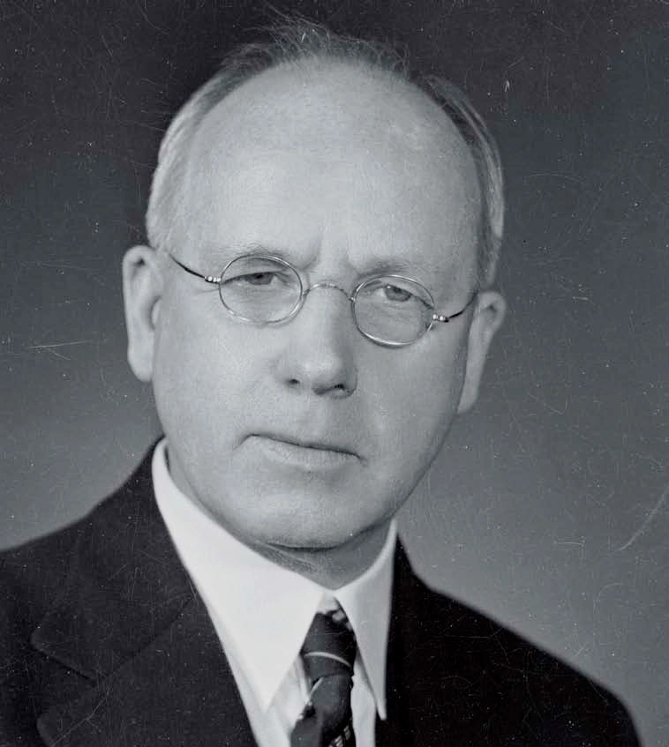
Sir Peter Fraser
Prime Minister 1941-1947
Notes:
Peter Fraser, who served as the Prime Minister of New Zealand from 1940 to 1949, was a supporter of the establishment of a Jewish state in Palestine.
Fraser had extensive contacts with New Zealand’s Jewish community and local and visiting Zionists. Like Savage, he was a close friend of the Jewish brewer, Ernest Davies. He attended a reception given by the Auckland Jewish community for David Ben-Gurion in January 1941 when Ben-Gurion was returning to Palestine after an unsuccessful attempt to arouse American Jewish opposition to the 1939 White Paper. When the Zionist Federation of New Zealand held its first Dominion Conference in Wellington in 1943, Fraser delivered an understanding and thoughtful address.
In addressing the United Nations delegates at the San Francisco Conference in April 1945, Fraser asserted that:
“Whatever can be done to help the persecuted Jewish people shall and must be done to the utmost ability of all right-thinking men…
There should be no antagonism or misunderstanding between the Jewish and Arab peoples, everyone living in Palestine would naturally benefit from what the Jewish people have made out of a land which was once desert, until the desert bloomed as a rose. Palestine is very akin to the ideals of New Zealand except that the Jewish people went into Palestine with a tradition of privation…
…I hope and believe that the representatives from this country who take part in the counsels stand foursquare for justice for the ancient home and new hope of the Jewish people.”
New Zealand supported the establishment of a Jewish state in Palestine, and voted in favor of the UN partition plan that called for the creation of separate Jewish and Arab states in Palestine.

Slide 5
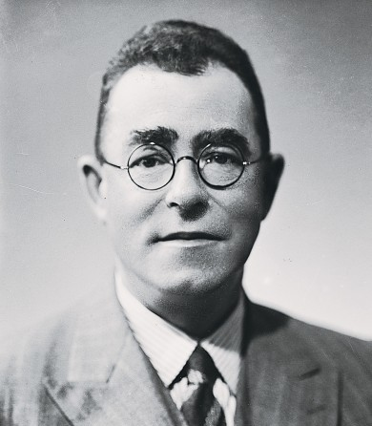
Sir Carl Berendsen
Head of the Prime Minister’s Department 1932-1943
High Commissioner to Australia. 1943-44
Minister to the United States 1944-1952
Member of the team headed by UN envoy Gunnar Jarring to establish peace following the Six-Day War 1967
Notes:
Yet the New Zealand Prime Minster was torn: He wanted the United Nations to succeed as an international body. He wanted Britain to be allowed to withdraw from Palestine. But he knew that without an international military presence, the Partition Plan would lead to war. He voiced his concerns to Carl Berendsen, New Zealand’s delegate to the United Nations.
By November 21, Fraser had made up his mind. He told the British Secretary of State that, “We must support partition as the solution which offers the best possible hope, however small, of dealing with the situation as it exists at the present time.”
However, Berendsen continued pushing the UN to delay the vote until a better solution was found, preferably with the United States committing to send soldiers to the region to enforce the decision.

Slide 6
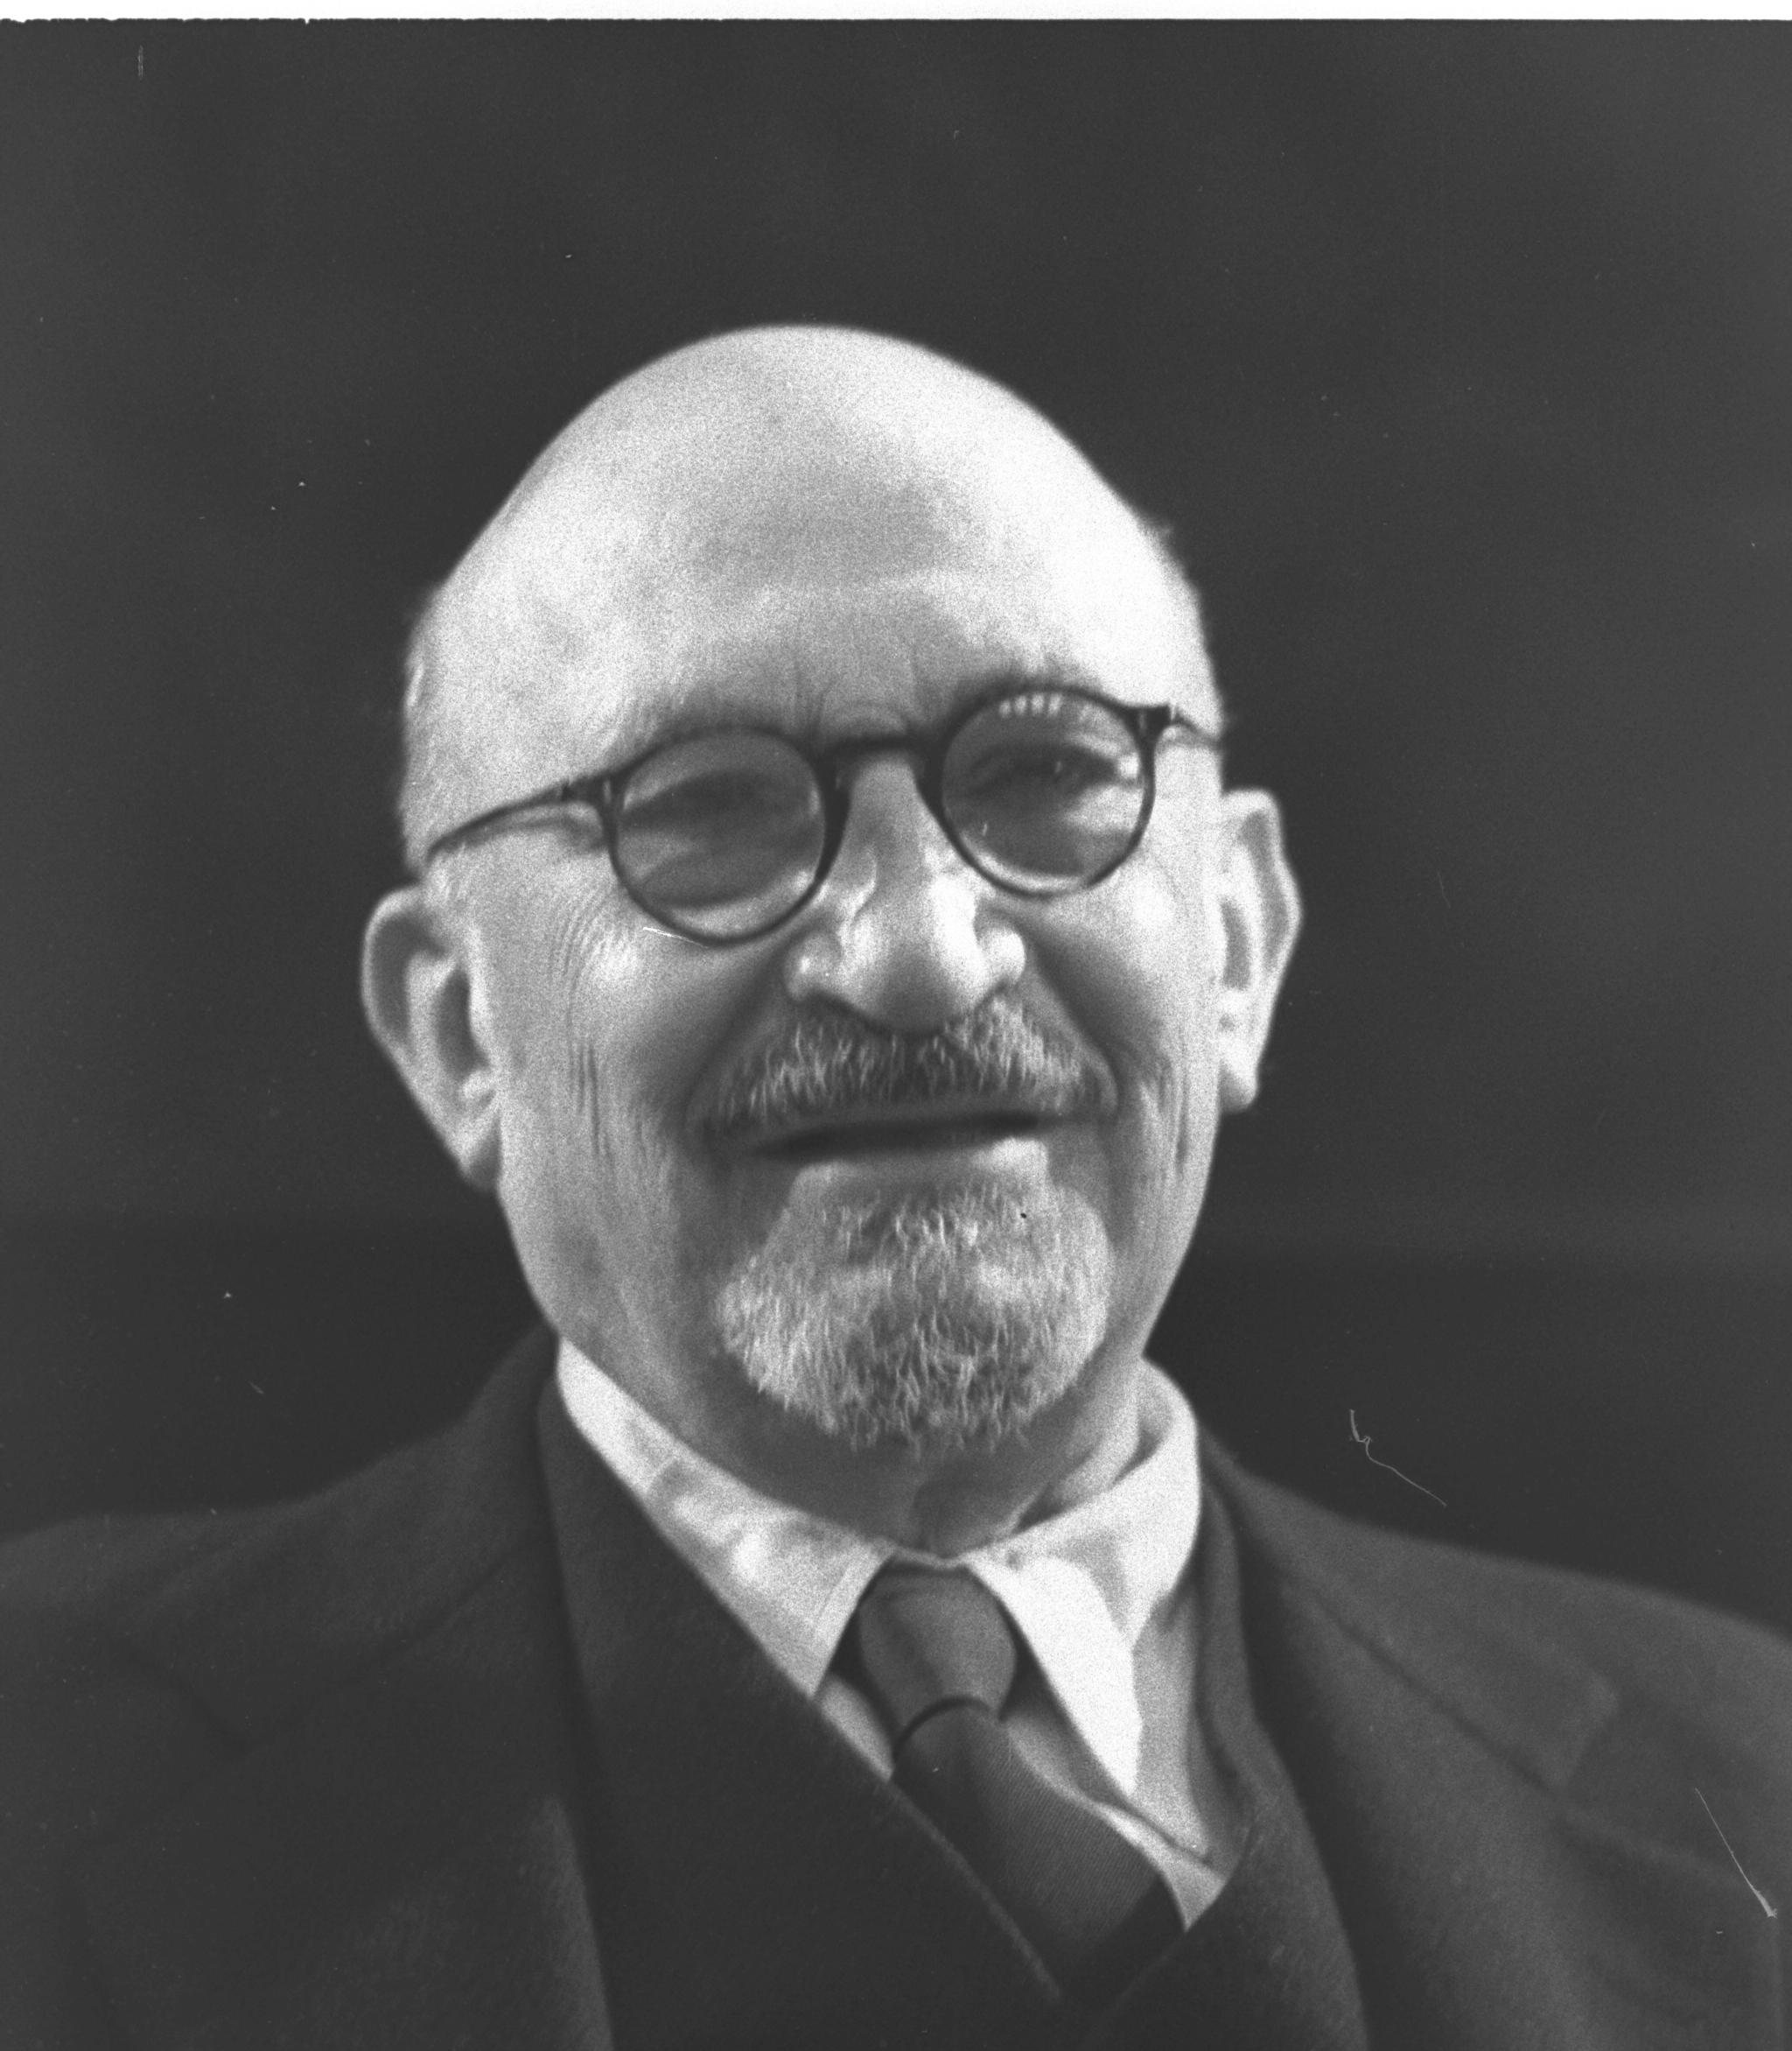
Chaim Weizmann
Chairman of the Provisional State Council 1948-1949
First President of Israel, 1949-1952
Notes:
On November 22, Chaim Weizmann, who would become Israel’s first president, sent a telegram to Fraser, stressing that if New Zealand abstained from the committee vote on partition, “through doubt on certain issues,” New Zealand would prejudice the only chance for a decision.
As the deadline for the vote approached, Fraser replied to Weizmann that partition without enforcement was, “futile and seems calculated to lead to bloodshed and chaos.”

Slide 7
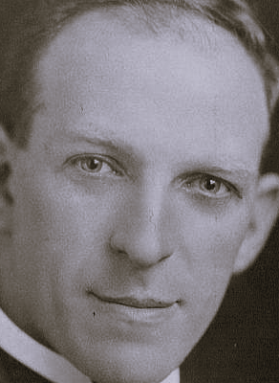
Isaac Gottlieb
Head of NZ Zionist Federation
Notes:
Yizthak Triester reported that: Isaac Gotlieb counted Berendsen as a friend and neighbour, though they did not see eye to eye on the issues of Judaism or Zionism. And Carl had his doubts about the partition plan.
By now, Fraser realized that without New Zealand’s vote, the Partition Plan may not receive the necessary two thirds majority. Although he feared the plan was flawed, he knew there was no alternative. So, before the vote, he went to discuss his options with Isaac Gottlieb.
Isaac Gotlieb was a passionate Zionist. In 1943, he became the first head of the New Zealand Zionist Federation. He traveled the country raising money for the Zionist cause, and in 1946, he represented New Zealand at the first World Zionist Convention in Basel.
Isaac Gotlieb was born in Latvia in 1891 and emigrated to NZ in 1909, having completed his apprenticeship as a carpenter in Wales, and after a few years, in 1924 at the age of 33 opened his own company called The Art Cabinet Co.
He became a very successful businessman. During the depression years, while others went bankrupt, Isaac and his brother Morris flourished.
He mixed in social circles that included Fraser, and other government officials. When the prime minister and his colleagues came to visit my great uncle on just before the partition vote, he employed every argument he had to convince them that they should support it. It worked.
In a speech to the New Zealand Parliament on 27 November 1947, Fraser stated his government's support for the partition plan, which proposed the creation of separate Jewish and Arab states in Palestine.
In his speech, Fraser said,
"It is the solemn duty of the General Assembly to create a free and independent state of Israel, and to guarantee it a secure existence in the world. This is an act of justice that we owe to the Jewish people, who have suffered so much in recent years. At the same time, we recognize the rights of the Arab people, and we hope that the two states will live side by side in peace and friendship."
On 29 November 1947, New Zealand was one of the 33 countries that voted in favour of the partition plan, while 13 countries voted against it and 10 abstained. New Zealand's support for the partition plan was based on its belief that the Jewish people had a legitimate claim to a homeland in Palestine, and that the partition plan was a fair and practical solution to the conflict between Jews and Arabs in the region.
After the establishment of Israel in 1948, New Zealand was one of the first countries to recognize its independence. New Zealand also provided military and other forms of support to Israel in its early years, including sending a small contingent of troops to serve with the United Nations Truce Supervision Organization (UNTSO) in the region.
75 years later, Fraser’s hopes for Israel have been realised. Today, Israel’s economy is a source of regional employment and wealth. With the Abrahamic Accords, regional peace is another step closer. And if further peace can be given a chance and maintained, then the economic windfall for all concerned, not just Jews, would be astronomical.
Today, Mr Ambassador, New Zealand continues to stand with Israel, affirming its right to exist, and working with Israel to ensure peace prevails, so that all may live and become anything they lawfully aspire to be.
In the desert, the Rose is blooming.
Thank you for your attention.

Slide 8
Welcome
Shmuel Korev
Member of the Board of Management
Canterbury Hebrew Congregation

Slide 9
NZ National Anthem: God of Nations
E Ihowā Atua, O ngā iwi mātou rā Āta whakarangona; Me aroha noa Kia hua ko te pai; Kia tau tō atawhai; Manaakitia mai Aotearoa | God of Nations at Thy feet, In the bonds of love we meet, Hear our voices, we entreat, God defend our free land. Guard Pacific's triple star From the shafts of strife and war, Make her praises heard afar, God defend New Zealand.
Notes:
https://www.youtube.com/watch?v=a-5g35zY0cU

Slide 10
Address
H.E. Ambassador Ran Jaakoby

Slide 11
Israel National Anthem: HaTikvah
כָּל עוֹד בַּלֵּבָב פְּנִימָה נֶפֶשׁ יְהוּדִי הוֹמִיָּה וּלְפַאֲתֵי מִזְרָח קָדִימָה עַיִן לְצִיּוֹן צוֹפִיָּה עוֹד לֹא אָבְדָה תִּקְוָתֵנוּ הַתִּקְוָה בַּת שְׁנוֹת אַלְפַּיִם לִהְיוֹת עַם חָפְשִׁי בְּאַרְצֵנוּ אֶרֶץ צִיּוֹן וִירוּשָׁלַיִם | Kol od ba’levav penimah Nefesh yehudi homiyah Ulefa’atei mizrach kadimah Ayin Le’Tzion, tzofiah. Od lo avdah tikvateinu Ha'tikvah bat sh'not alpayim Lihyot am chofsi be’artzenu Eretz Tzion v’Yerushalayim (repeat last two lines) | English translation (not for singing) So long as still within our breasts The Jewish heart beats true, So long as still towards the East, To Zion, looks the Jew, So long our hopes are not yet lost Two thousand years we cherished them To live in freedom in the land Of Zion and Jerusalem.
Notes:
https://www.youtube.com/watch?v=U8eXXUxdjKk

Slide 12
Farewell
Tony Kan
President
NZ Friends of Israel Association Inc
Notes:
Folks, thanks again for taking the time to come out and share in this special occasion.
Please do take home a balloon or two as a momento.
Before you go, I’d like to thank you, Shmuel member of the Board of Management of the Canterbury Hebrew Congregation for all your help in getting this event going. I’d also like to thank Rebecca Marchand, our secretary for ably organizing the ticket sales and communicating with ticketholders, to Yoko Allan, David Allan, Alison Clarke and John Clarke for all their work in scouting out the venue and for handling the decorations. I’d also like to thank you all for your support, without which this event would not be possible.
And of course, I’d like to thank the Ambassador himself for making the time to come, for sponsoring the event, and for the Israel-NZ badges, which may be obtained from Sarah.
The Torah Prophet, Zechariah said,
Thus says the Lord: I have returned to Zion and will dwell in the midst of Jerusalem, and Jerusalem shall be called the faithful city, and the mountain of the Lord of hosts, the holy mountain.
4 Thus says the Lord of hosts: Old men and old women shall again sit in the streets of Jerusalem, each with staff in hand because of great age.
5 And the streets of the city shall be full of boys and girls playing in its streets.
6 Thus says the Lord of hosts: If it is marvelous in the sight of the remnant of this people in those days, should it also be marvelous in my sight, declares the Lord of hosts?
7 Thus says the Lord of hosts: Behold, I will save my people from the east country and from the west country,
8 and I will bring them to dwell in the midst of Jerusalem. And they shall be my people, and I will be their God, in faithfulness and in righteousness.”
And the Torah prophet Ezekiel said:
37:1 The hand of the Lord was upon me, and he brought me out in the Spirit of the Lord and set me down in the middle of the valley; it was full of bones.
2 And he led me around among them, and behold, there were very many on the surface of the valley, and behold, they were very dry.
3 And he said to me, “Son of man, can these bones live?” And I answered, “O Lord God, you know.”
4 Then he said to me, “Prophesy over these bones, and say to them, O dry bones, hear the word of the Lord.
5 Thus says the Lord God to these bones: Behold, I will cause breath to enter you, and you shall live.
6 And I will lay sinews upon you, and will cause flesh to come upon you, and cover you with skin, and put breath in you, and you shall live, and you shall know that I am the Lord.”
7 So I prophesied as I was commanded. And as I prophesied, there was a sound, and behold, a rattling, and the bones came together, bone to its bone.
8 And I looked, and behold, there were sinews on them, and flesh had come upon them, and skin had covered them. But there was no breath in them.
9 Then he said to me, “Prophesy to the breath; prophesy, son of man, and say to the breath, Thus says the Lord God: Come from the four winds, O breath, and breathe on these slain, that they may live.”
10 So I prophesied as he commanded me, and the breath came into them, and they lived and stood on their feet, an exceedingly great army.
11 Then he said to me, “Son of man, these bones are the whole house of Israel. Behold, they say, ‘Our bones are dried up, and our hope is lost; we are indeed cut off.’
12 Therefore prophesy, and say to them, Thus says the Lord God: Behold, I will open your graves and raise you from your graves, O my people. And I will bring you into the land of Israel.
13 And you shall know that I am the Lord, when I open your graves, and raise you from your graves, O my people.
14 And I will put my Spirit within you, and you shall live, and I will place you in your own land. Then you shall know that I am the Lord; I have spoken, and I will do it, declares the Lord.”
Zechariah spoke around 520 BCE and Ezekiel 586 BCE: They spoke over 2,500 years ago.
Can we not stand back and behold what has happened and not be marvelled?
The Holy Bible: English Standard Version (Zec 8:3–8). (2016). Crossway Bibles.
The Holy Bible: English Standard Version (Eze 37:1–14). (2016). Crossway Bibles.

Slide 13
Am Yisrael Chai!
The People of Israel Live!
עם ישראל חי!
Notes:
Am Yisrael chai, the People of Israel live!
Please join me in saying it again.
Am Yisrael chai, the People of Israel live!
And again.
Am Yisrael chai, the People of Israel live!
As you leave with that thought to ponder, may you return to your homes safely. Thank you.

