Slide 1
Being Jewish in today’s World
NZFOI AGM 2023
By Rob Berg

Slide 2
Today’s talk
My background
Being Jewish in New Zealand
Being Jewish in today’s world
BDS
Israel colonialist myth

Slide 3
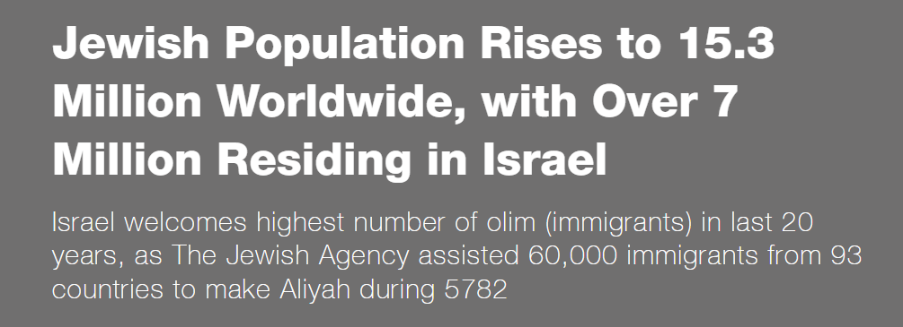
World Jewish Population – 25 Sept 2022

Slide 4
World Jewish Population – 25 Sept 2022
15.3m – increase of 100k from 2021
Israel: 7,080,000 in 2022, increase of 130k from 2021 (6,950,000)
World Jewish population in 1933 – 16.6m
At current growth rate will be another 13 years before we reach pre Holocaust population
Number of Jews in Israel has increased 10-fold since the establishment of the state in 1948 when there were 650,000 Jews in the country.

Slide 5
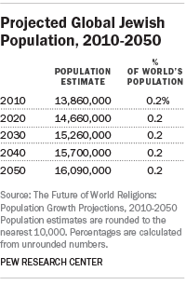
Top 10 Highest Jewish populations outside of Israel
USA: 6,000,000
France: 442,000
Canada: 394,000
United Kingdom: 292,000
Argentina: 173,000
Russia: 145,000
Australia: 118,200
Germany: 118,000
Brazil: 91,000
South Africa: 51,000
NZ has ~6,000 Jews

Slide 6
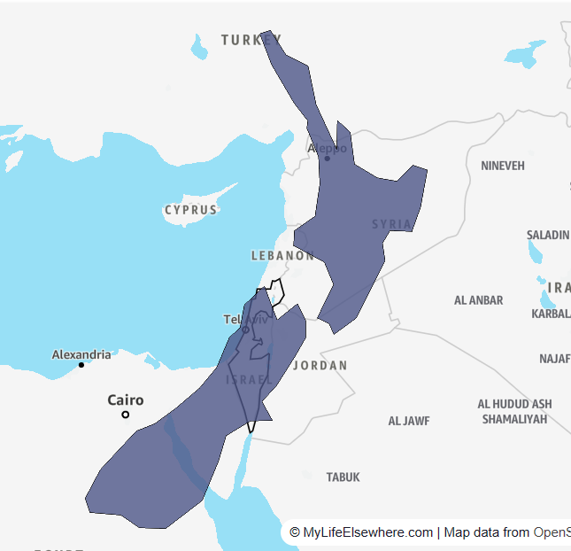
Israel compared to New Zealand
Israel is about 12 times smaller than New Zealand.
New Zealand is approximately 268,838 km²
Israel is approximately 21,937 km²
Israel 8.16% the size of New Zealand

Slide 8
Jews in New Zealand
2018 NZ Census- Jewish of Jews as per indicating Judaism/Jewish religious affiliation in response to the question on religion was 5,274
Number of people that also reported their ethnicity as Israeli/Jewish was 1854
Is likely to be some overlapping of above numbers
Religion figure is also significantly lower (23%) than the 2013 NZ Census figure of 6867

Slide 9
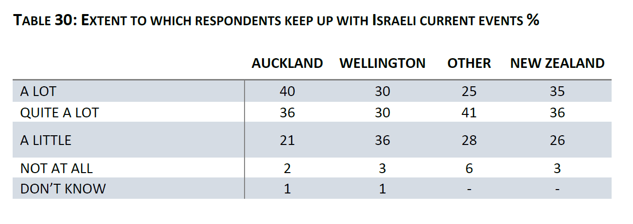
NZ Jews and Israel
A fifth of respondents would choose to reside in Israel if they were not in New Zealand.
Linkages with Israel were high in that two-thirds or more had family in Israel

Slide 10
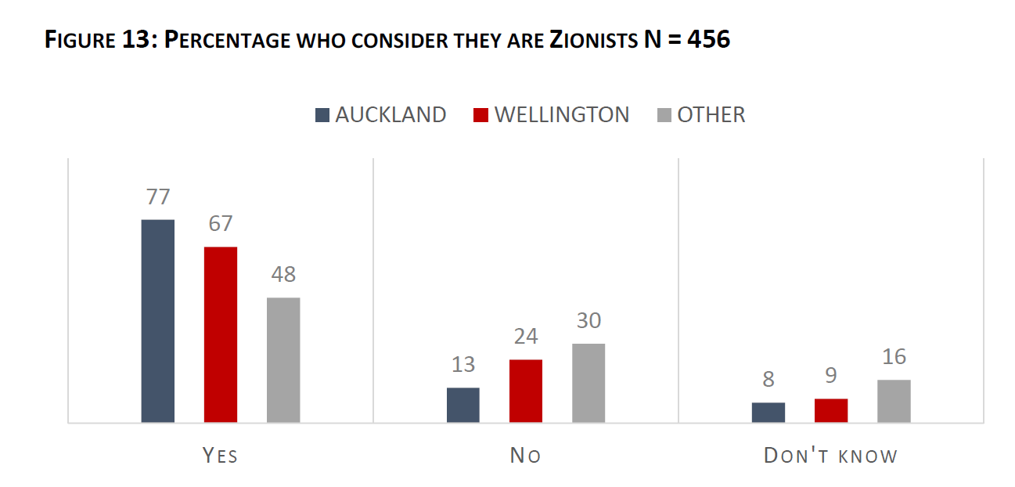
NZ Jews and Israel

Slide 11
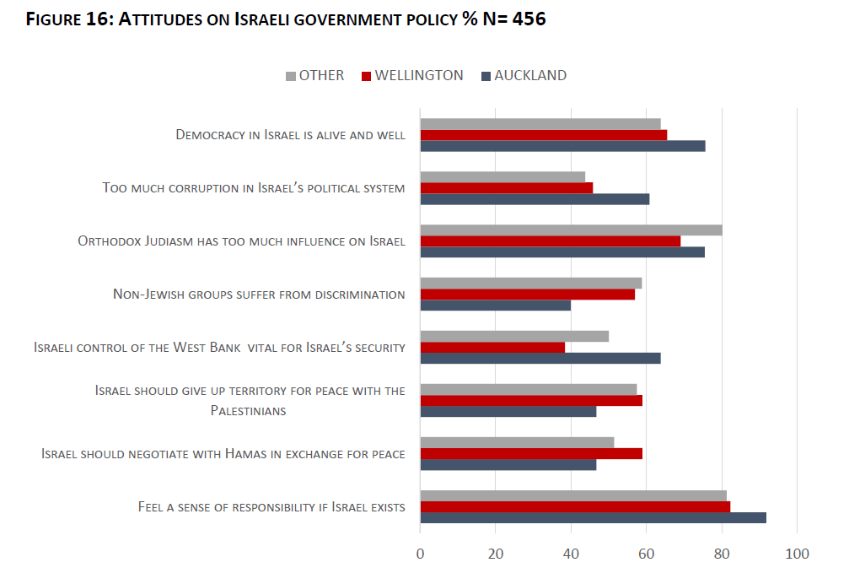
NZ Jews and Israel

Slide 12
NZ Jews and Jewish identity

Slide 13
NZ Jews and antisemitism
When it came to antisemitism, there was a significant degree of agreement with the majority identifying it as an issue.
In 2008 survey, 83% felt antisemitism was not a serious problem in NZ
In 2019 - 70 respondents had experienced a verbal insult or harassment
3 had been physically attacked
363 respondents (52%) had not experienced any of these forms of antisemitism.
16% had experienced antisemitic insults or harassment

Slide 14
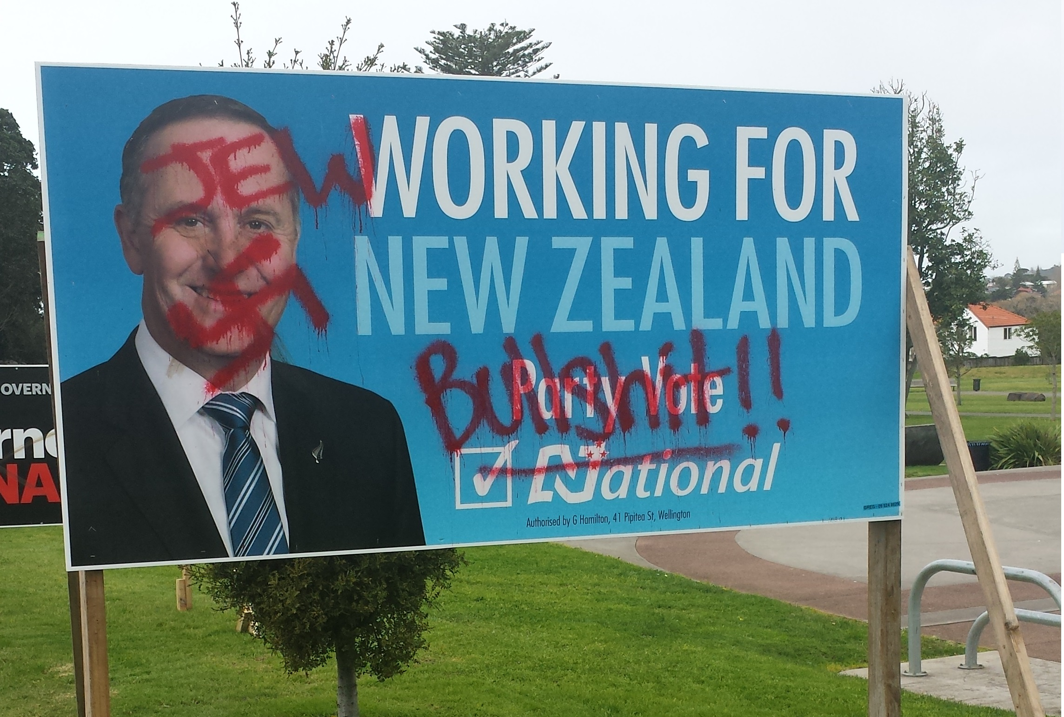
NZ Jews and antisemitism

Slide 15
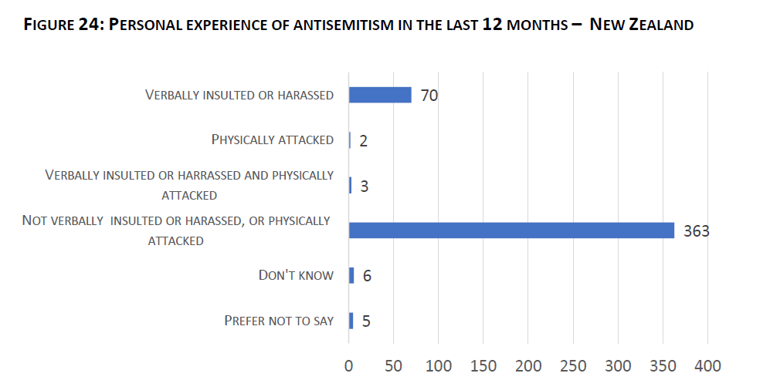
NZ Jews and antisemitism

Slide 16
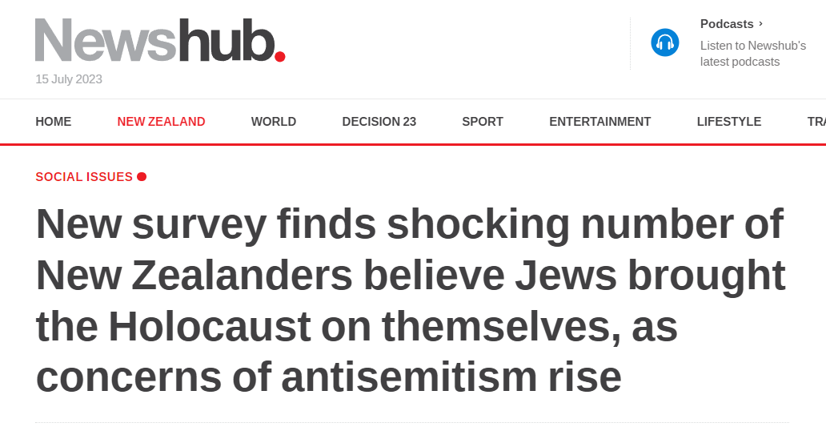
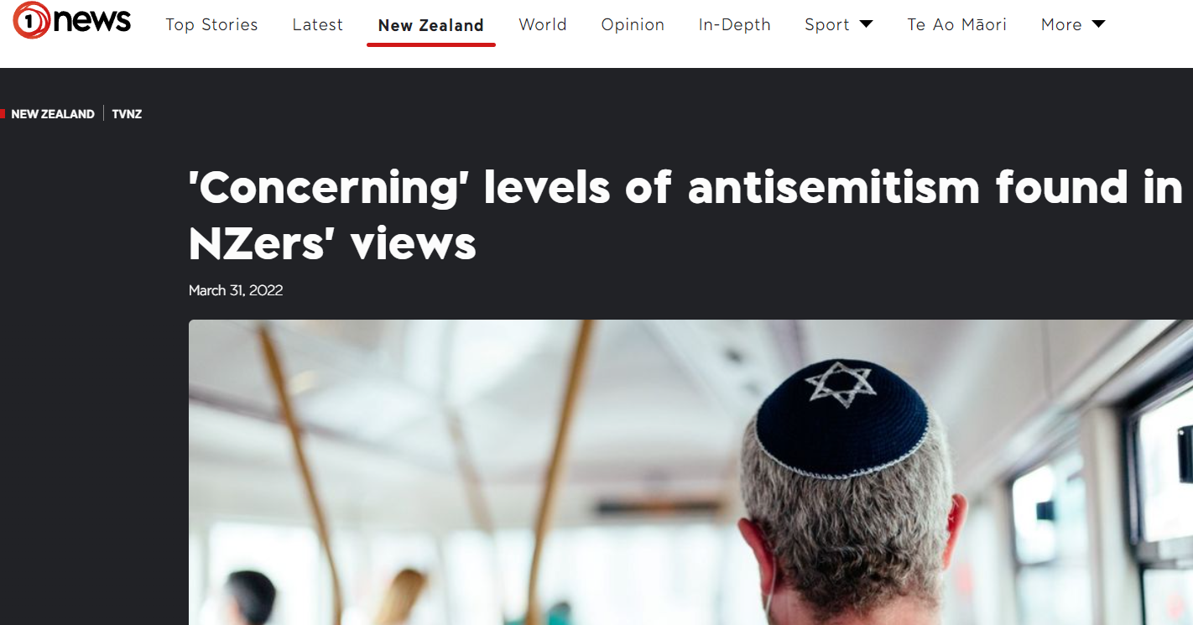
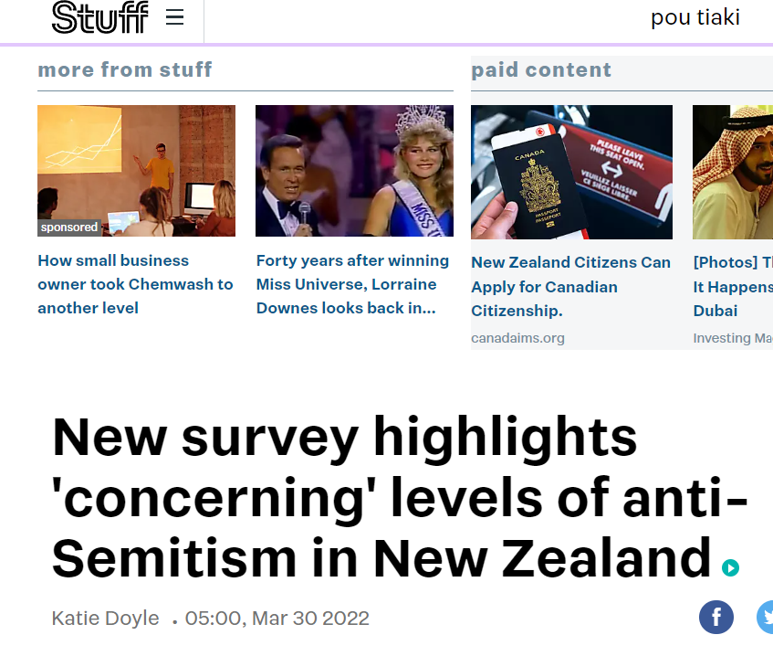
NZ Jews and antisemitism - Antisemitism Survey of New Zealand 2021

Slide 17
NZ Jews and antisemitism - Antisemitism Survey of New Zealand 2021
Gluckman said anti-Israel sentiment and ‘Zionophobia’ could be used as a cover for deeper anti-Semitic views.
The survey revealed 21 per cent of respondents held two or more classical anti-Semitic views, agreeing with statements like “Jews have too much power in international financial markets”, and 6 per cent of those surveyed held nine or more anti-Semitic views.
The survey also found that older people, between the ages of 61 to 75, were 4.1 times more likely to say they knew a great deal about the Holocaust compared to 18 to 30-year-olds.
Only 42 per cent knew that six million Jews were killed during the Holocaust.
Older people, between 61 and 75, were three times as likely to get the answer right compared to 18 to 35-year-olds.
But even within the older age group, only 59 per cent answered correctly, the survey said.
The Survey of Antisemitism in New Zealand 2021, released on Wednesday, involved 1017 people. Of those people, the survey found that 63 per cent of them held at least one antisemitic view.
Former New Zealand chief science advisor, Sir Peter Gluckman, who wrote the foreword for this survey, said in a statement that the information showed that “classic antisemitism has re-emerged - particularly during the pandemic - as Holocaust denial has become conflated with conspiracy theories and alt-right politics”.
“Another recent trend is the global emergence of left-wing antisemitism.

Slide 18
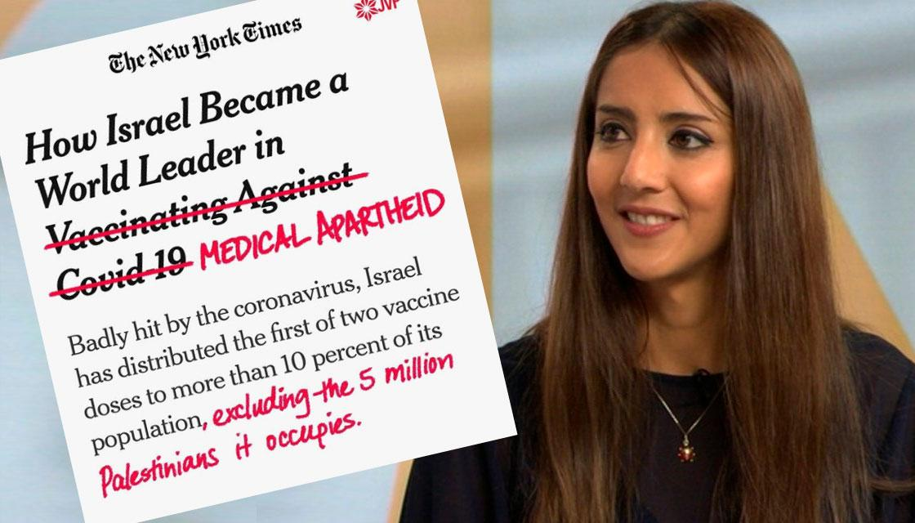
NZ Jews, antisemitism and anti-Zionism

Slide 19
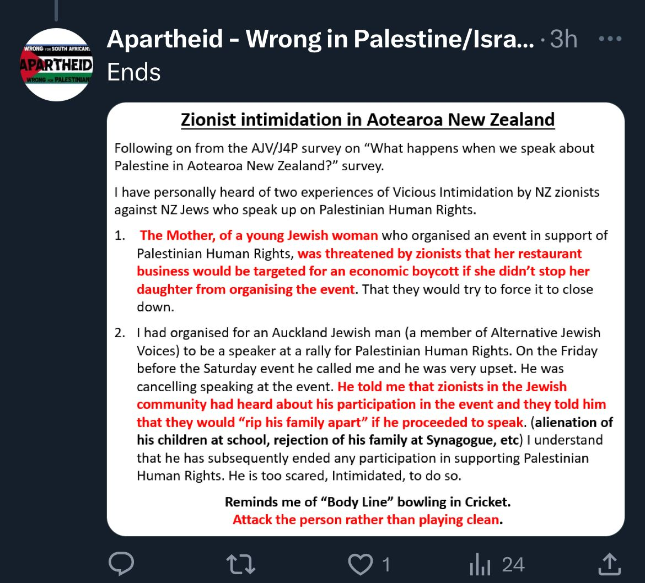
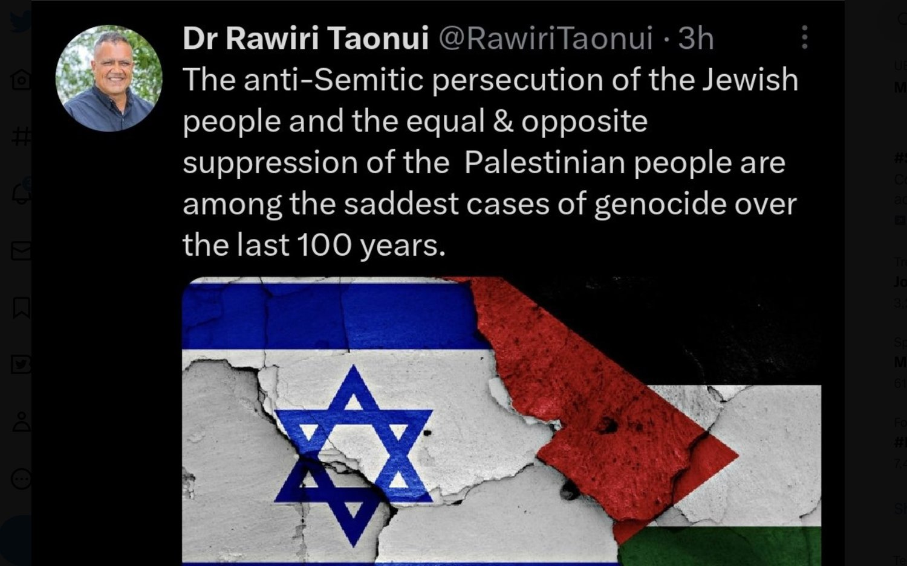
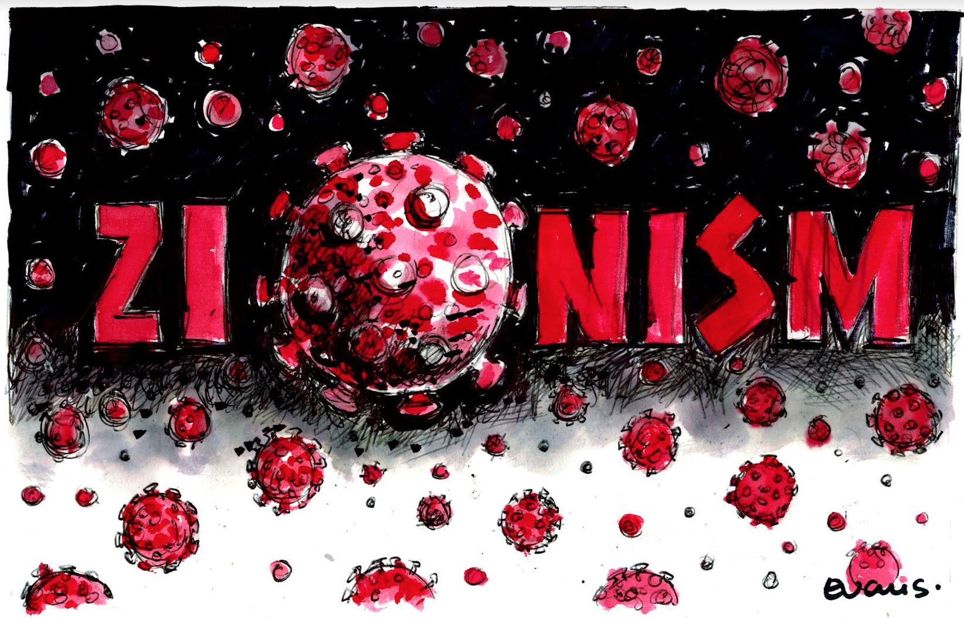
NZ Jews, antisemitism and anti-Zionism

Slide 20
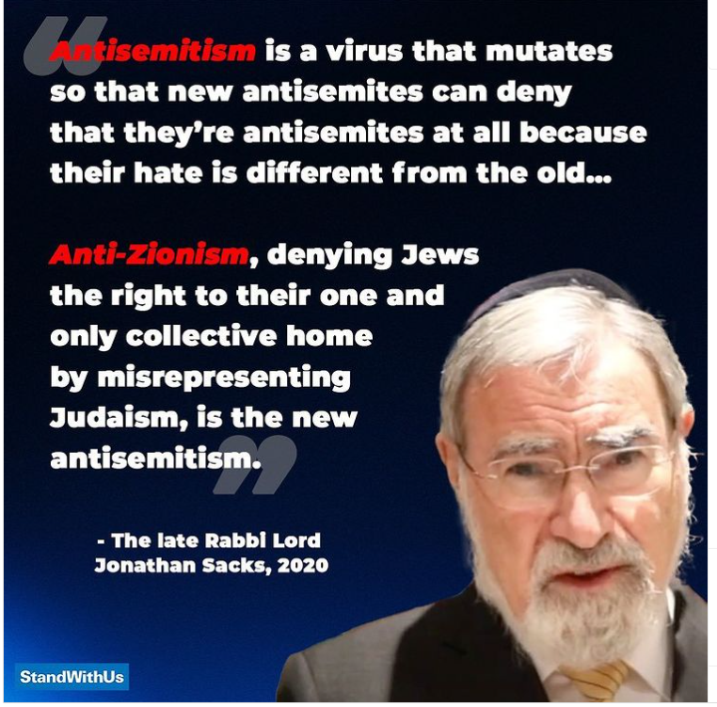
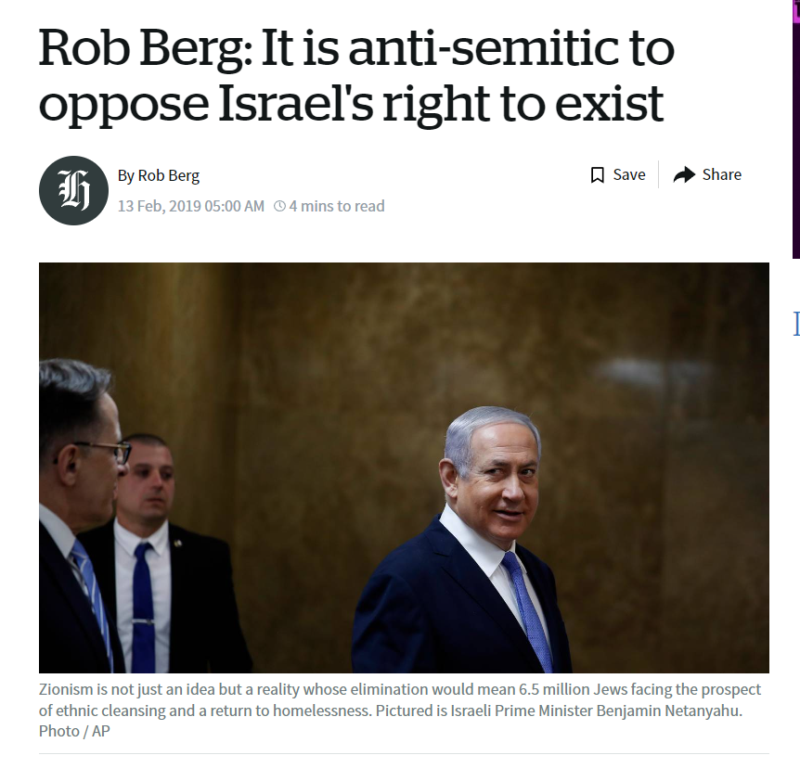
Anti-Zionism and antisemitism

Slide 21
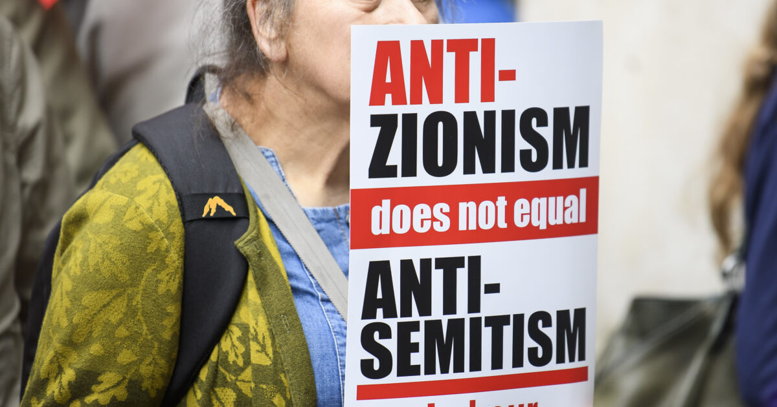
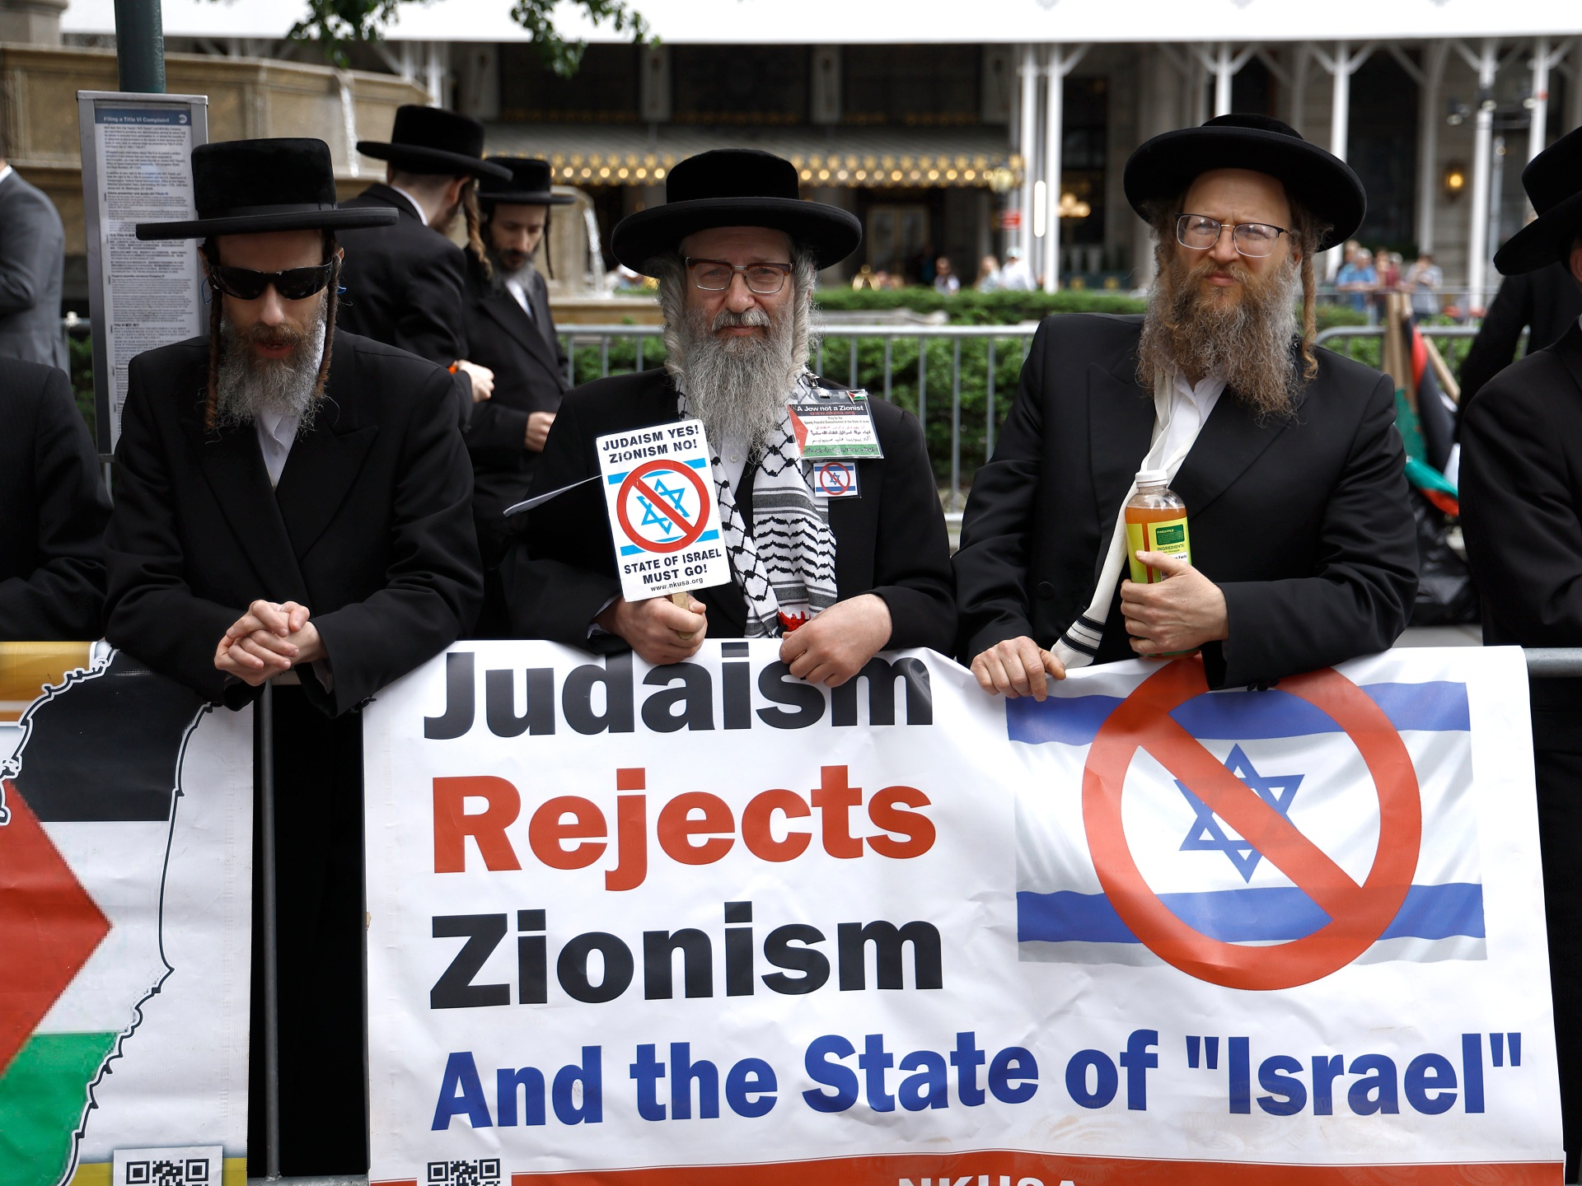
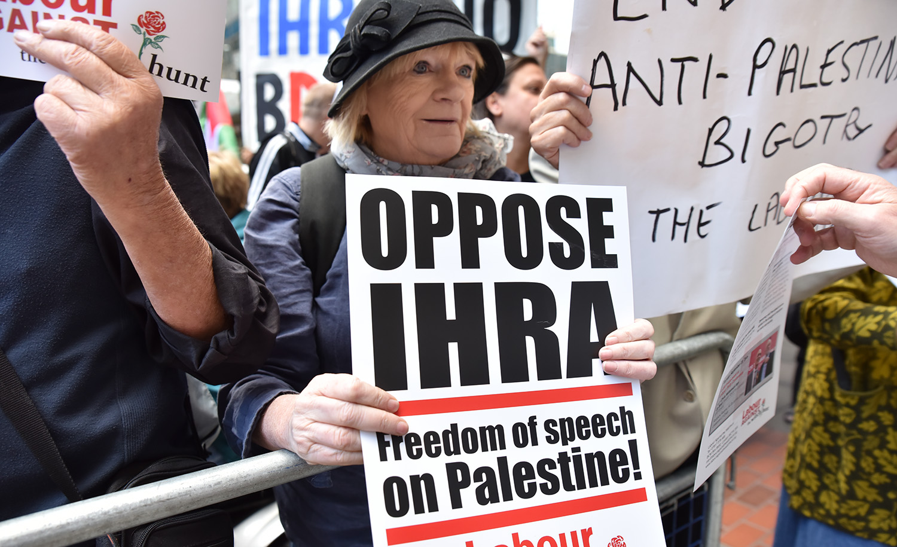
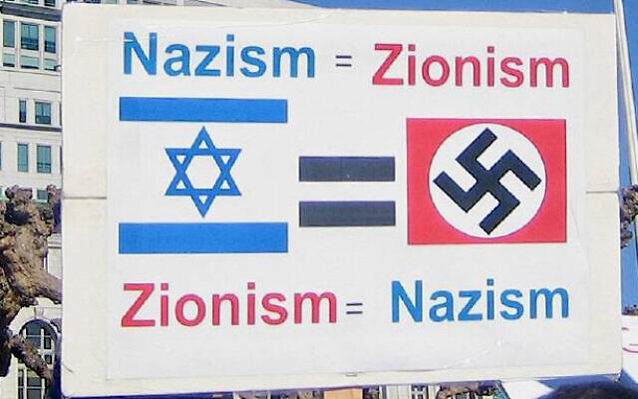
Whitewashing antisemitism

Slide 22
International Holocaust Remembrance Alliance (IHRA)
Adopt the following non-legally binding working definition of antisemitism: “Antisemitism is a certain perception of Jews, which may be expressed as hatred toward Jews. Rhetorical and physical manifestations of antisemitism are directed toward Jewish or non-Jewish individuals and/or their property, toward Jewish community institutions and religious facilities.
Manifestations might include the targeting of the state of Israel, conceived as a Jewish collectivity. However, criticism of Israel similar to that levelled against any other country cannot be regarded as antisemitic. Antisemitism frequently charges Jews with conspiring to harm humanity, and it is often used to blame Jews for “why things go wrong.” It is expressed in speech, writing, visual forms and action, and employs sinister stereotypes and negative character traits.

Slide 23
Natan Sharansky – 3D Test of Antisemitism
Demonisation
Double standards
Delegitimisation

Slide 24
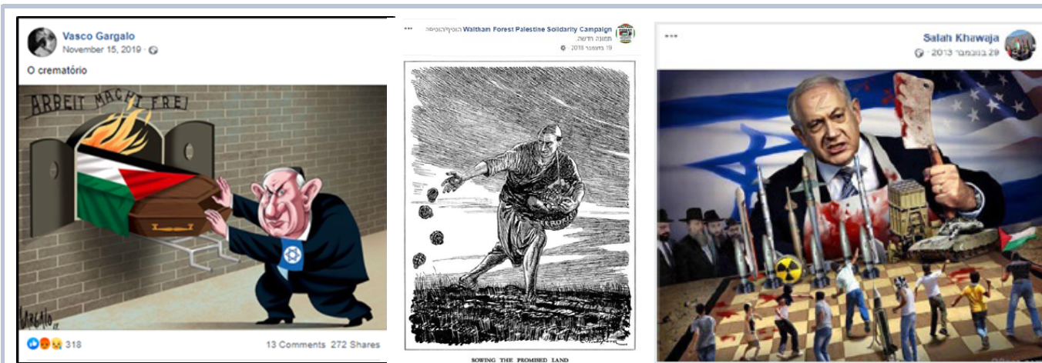
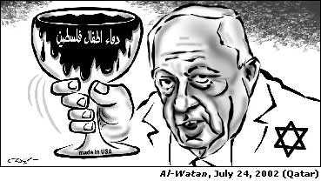
Global antisemitism

Slide 25
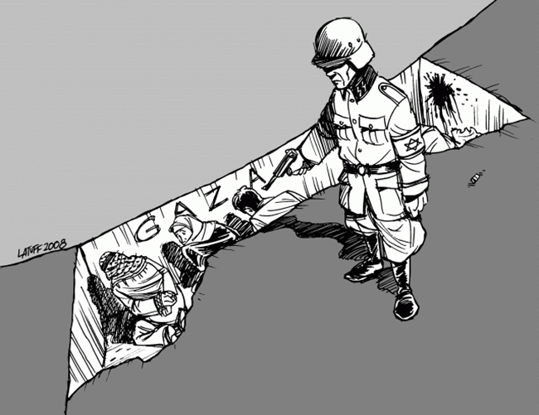
Global antisemitism

Slide 26
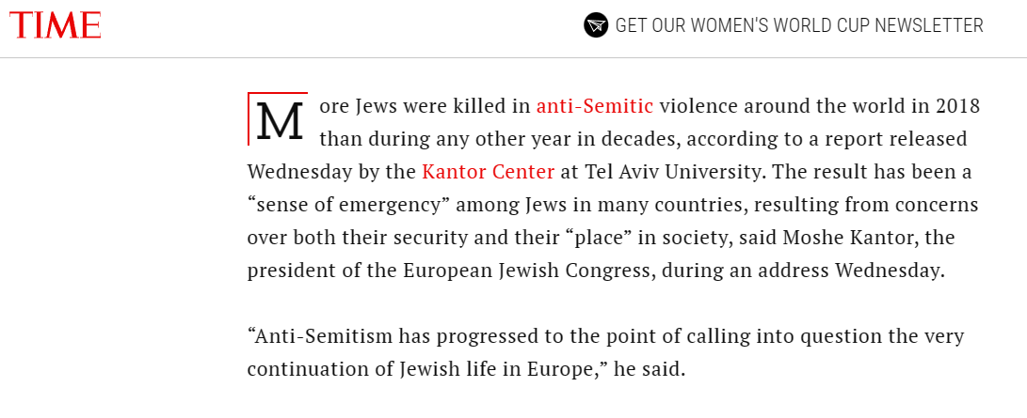
Global antisemitism

Slide 27
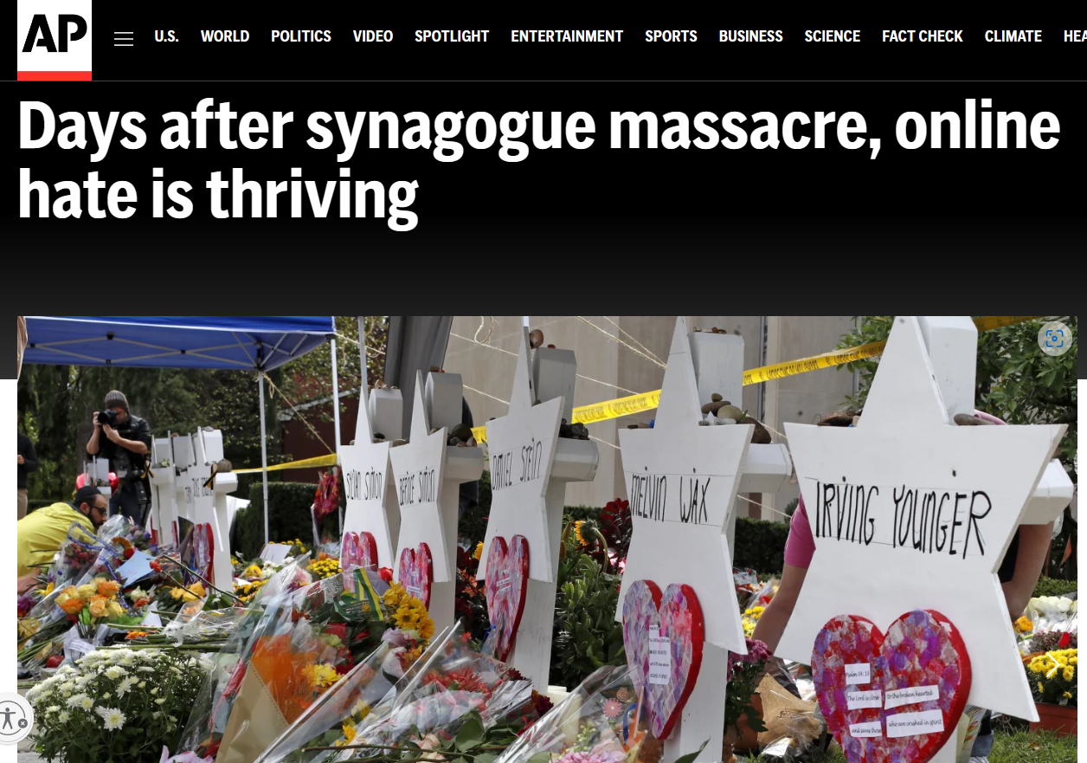
Global antisemitism

Slide 28
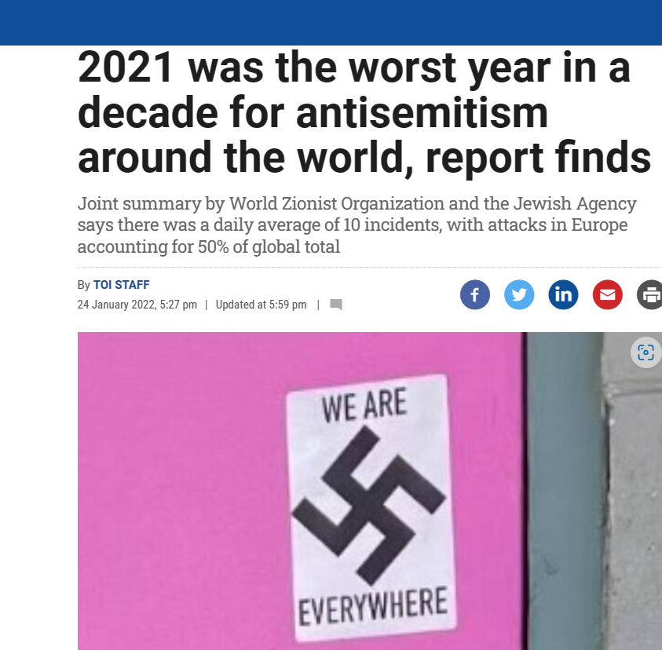
Global antisemitism
Europe was the leading continent in the number of antisemitic incidents during 2021, with close to 50 percent of all incidents globally taking place there.
The UK recorded a 49% increase in the first six months of 2021, with 1,308 incidents compared to 875 in the same period in 2020. Austria also recorded a doubling of the number of incidents, while in Germany the rate stayed roughly the same, with 1,850 antisemitic incidents recorded in the first 10 months of 2021 compared to 1,909 cases reported in all of 2020, according to the report.
In the German capital Berlin, 522 antisemitic incidents were recorded in the first half of 2021, an increase of about 27% compared to 2020, when there were 410 recorded incidents in the first six months.

Slide 29
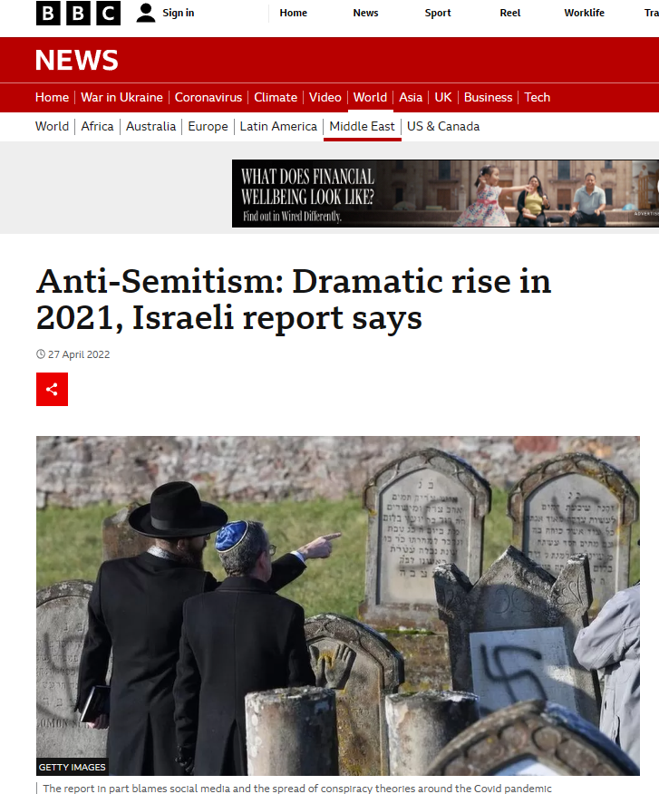
Global antisemitism
The report identifies the US, Canada, the UK, Germany and Australia as among countries where there was a sharp rise
This was fuelled by radical left- and right-wing political movements and incitement on social media
In the US, which has the largest Jewish population outside of Israel, the number of anti-Jewish hate crimes recorded in both New York and Los Angeles were almost twice that of the previous year
In France, the number of recorded anti-Semitic incidents increased by almost 75% compared with 2020
In Canada, a leading Jewish group reported a 40-year record in anti-Semitic physical violence in one month - August
In the UK, the number of recorded physical assaults against Jews increased by 78% compared with 2020
In Germany, anti-Semitic incidents recorded by police were up 29% compared with 2020, and 49% compared with 2019
Australia also experienced a sharp rise in recorded anti-Semitic incidents, with 88 in May alone - the highest monthly total ever
(Data from 2021)

Slide 30
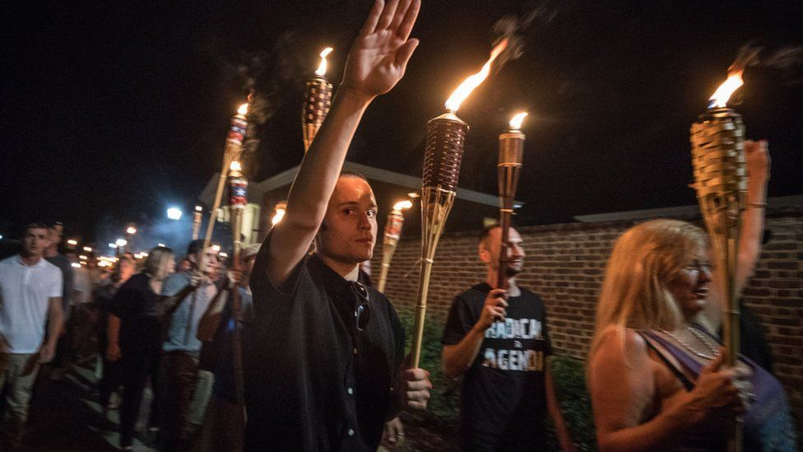
Global antisemitism
ADL – antisemitic incidents in USA reached all-time high in 2021
New York - 2021, with a total of 2,717 incidents of assault, harassment and vandalism reported to ADL (the Anti-Defamation League).
This represents the highest number of incidents on record since ADL began tracking antisemitic incidents in 1979 – an average of more than seven incidents per day and a 34 percent increase year over year.
88 incidents of assault, 1,776 incidents of harassment, 853 incidents of vandalism
Antisemitic incidents in France increased by 75% in 2021
589 hate crimes against Jews last year, including a 36% increase in physical assaults over 2020
Use of weapons, mostly knives and guns, in antisemitic incidents was also unusually high in 2021, occurring in 20% of all assaults and 10% of all cases of intimidation
2021, guards protecting a Jewish school in Marseille overpowered a man wielding a knife whom they suspected intended to stab patrons at a nearby kosher store and bakery.
At a 2017 rally in Charlottesville, far-right activists chanted "Jews will not replace us"

Slide 31
Global antisemitism
CST (Community Security Trust) – UK antisemitic incidents reached a record high in the UK last year
recorded reports of 2,255 anti-Jewish hate incidents in 2021, up 34% on 2020.
half of the incidents were in Greater London, with 1,254 cases, making it the worst year ever recorded in the city
the number of violent attacks reported rose by 76% from 100 in 2020 to 176 in 2021.
May 2021, when the violence peaked, the CST recorded its highest ever monthly total of 661 anti-Semitic incidents, and June saw the fifth highest with 210 incidents
Home Secretary Priti Patel said the Jewish community had been "subject to appalling hatred

Slide 32
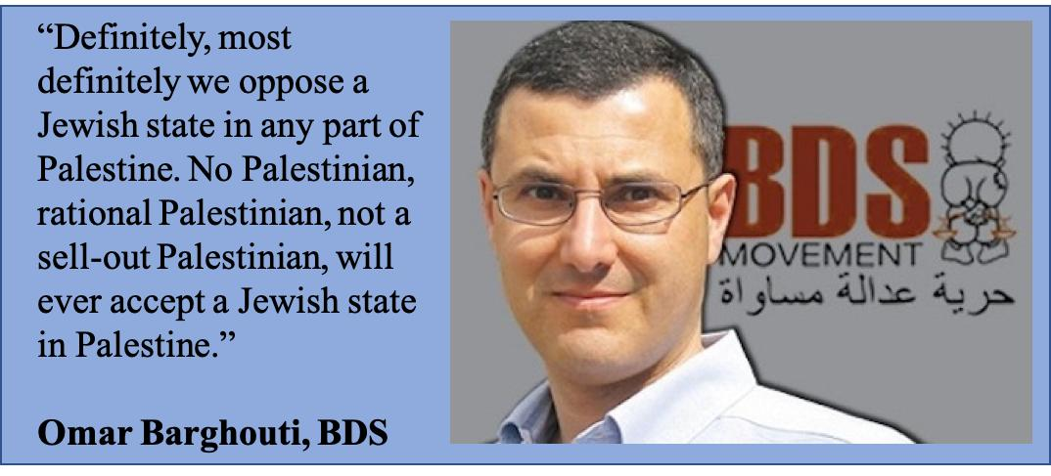
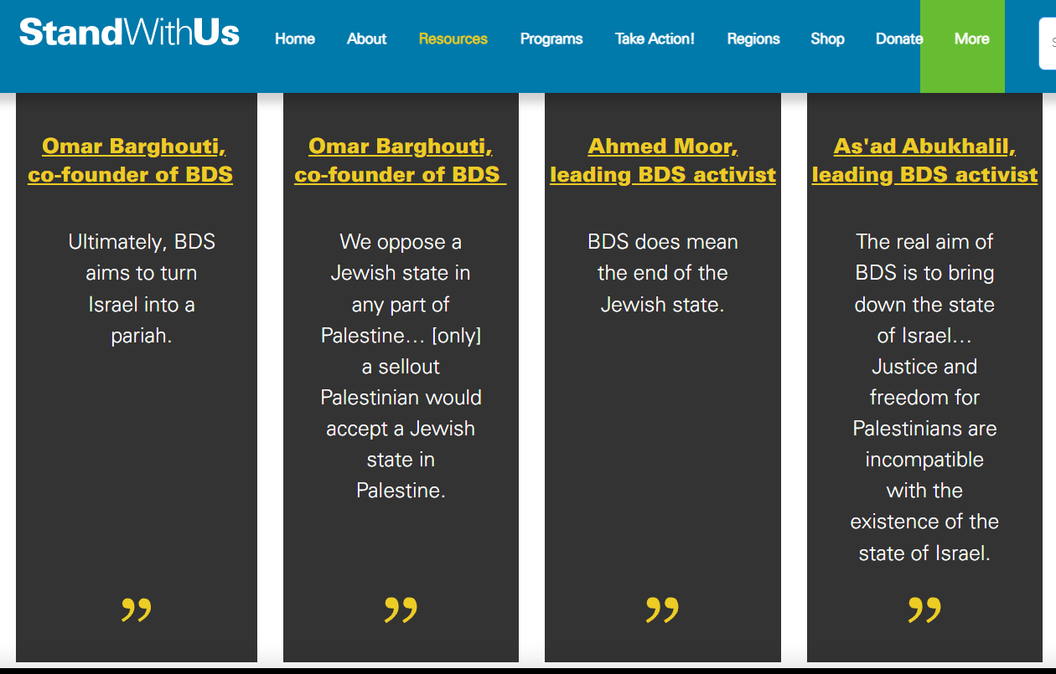
BDS (Boycott, Divestment, Sanctions)

Slide 33
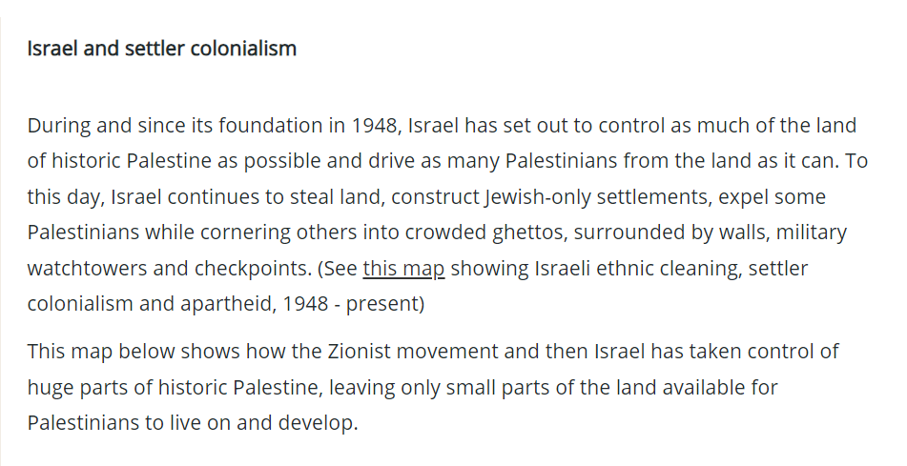
Israeli Jewish colonial slur
From BDS website

Slide 34
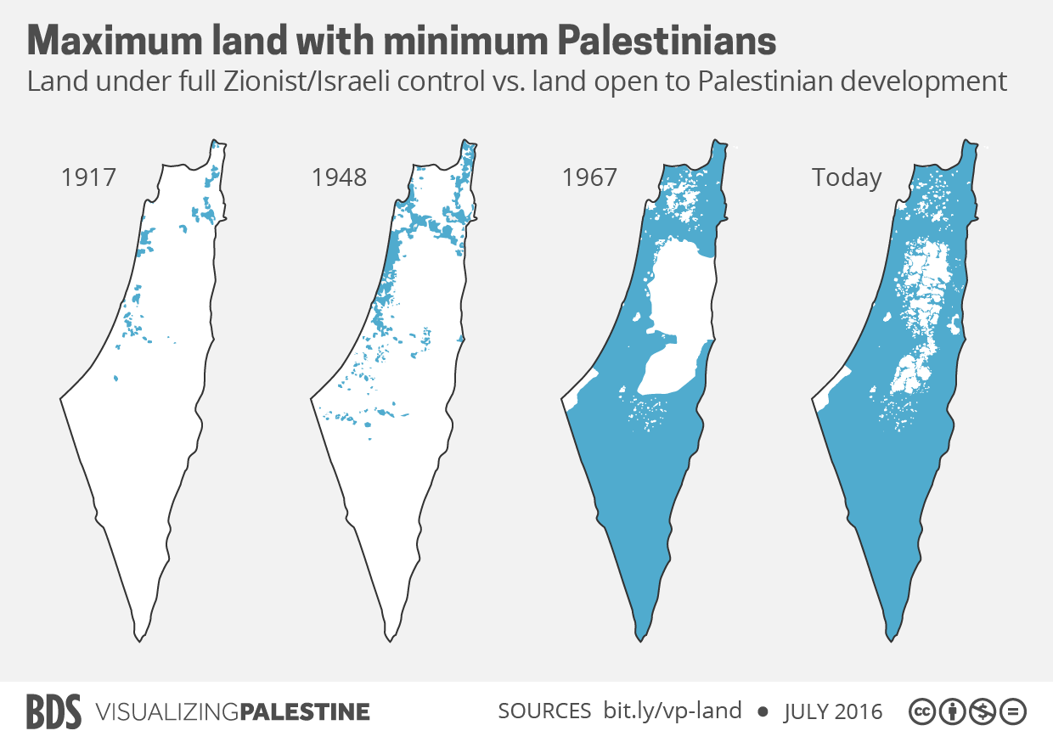
Israeli Jewish colonial slur

Slide 35
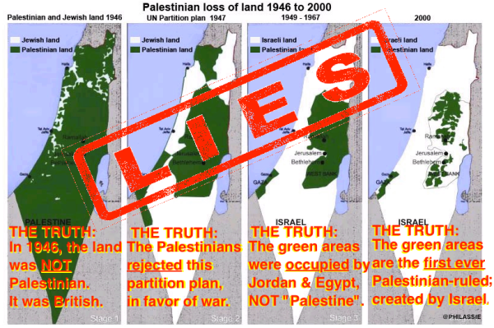
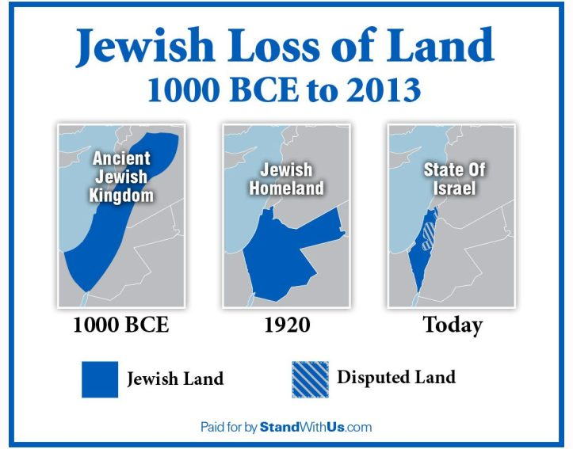
Israeli Jewish colonial slur

Slide 36
Key points for Israel in NZ Context
Jews as indigenous to the land
Jewish history and connection to the land of Israel
PA views on social issues such as
Women’s rights
LGBTI
Normalisation of relationships with Jews
Real apartheid is towards Jews in PA controlled areas

