Slide 1
Gaza
NZ Friends of Israel Assoc Inc
AGM

Slide 2
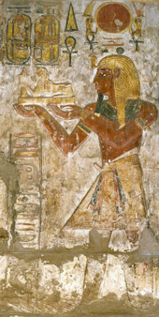
Gaza: Ancient History
4,000 year known history
Originally a Canaanite settlement
Controlled for 350 years by Ancient Egypt
Settled by Philistines in 1180 BC under Rameses III

Slide 3
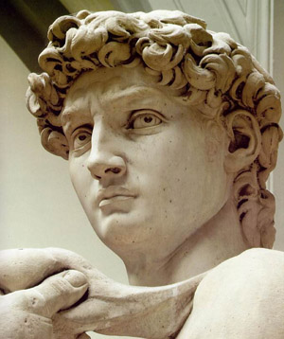
Gaza: Biblical Record
Samson met his death there (Jdg 16:21)
Prophets Amos & Zephaniah predicted it would be destroyed & desolation (Amos 1:7, Zeph 2:4)
Conquered by King David in 1000 BC

Slide 4
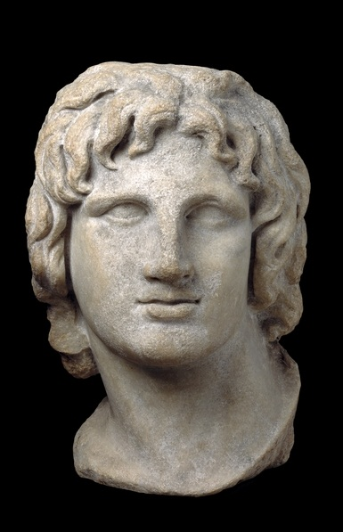
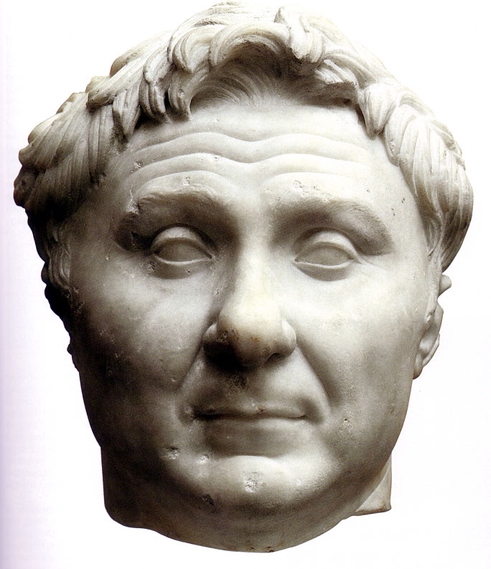
Gaza: Ancient History
Assyria conquers Israel 730 BC
Persia conquers Assyria
Alexander the Great conquers 332 BC
Changed hands between Seleucids & Ptolemies
Rebuilt by Pompey 63 BC

Slide 5
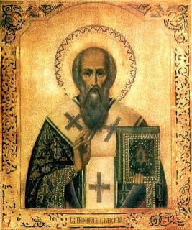
Gaza: First Millenium
Became part of the Byzantine Empire after the Roman Empire broke up
Fully Christianized under St Porphyrius, 420 AD
Fell to Islamic conquest, 635 AD

Slide 6
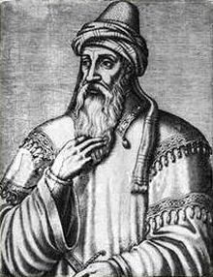
Gaza: Medieval Era
Reconquered by Crusaders, 1100 AD
Fell to Saladin in 1187
Incorporated into the Ottoman Empire in 16th Century
Ottoman Empire enters WW1 siding with the Central Powers in 1914

Slide 7
Gaza: WW1
McMahon-Hussein Correspondence promises Arab independence if they revolt, 1915-16

Slide 8
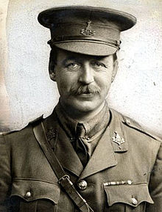
Gaza: WW1
Sykes-Picot Agreement divides region between UK and France, 1916
Arabs see this as a betrayal of the McMahon-Hussein promises

Slide 9
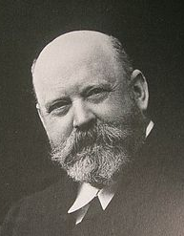
Gaza: WW1
Balfour Declaration, 1917: Letter from Balfour (Minister of Foreign Affairs) to Baron Rothschild
Promises a Jewish homeland
Incorporated into Sevres Treaty w Ottoman Empire

Slide 10
Gaza: British Mandate
British seek to legitimize rule
League of Nations grants Mandate to rule, 1920
Mandate incorporates Balfour Declaration
City population expands

Slide 11
Gaza: Post WW2
UN partition plan assigns Gaza to Arab Palestinian State
1948 Arab-Israeli War swells Gaza population
All-Palestine Govt declared, 1948
Client govt of Egypt
Absorbed into UAR, 1959, no citizenship

Slide 12
Gaza: 1960s-2014
Israel conquers Gaza, 1967
Gaza becomes centre of political resistance during the first Intifada, 1987-1993
1993 Oslo Accords puts Gaza under PA jurisdiction

Slide 13
Gaza: 1960-2014
Israel withdraws from Gaza in 2005
Hamas emerges as sole governing authority in factional fight with PA, 2007
Israel declares military blockade
Qassam rockets provoke Israeli assault 2008-9: Operation Cast Lead

Slide 14
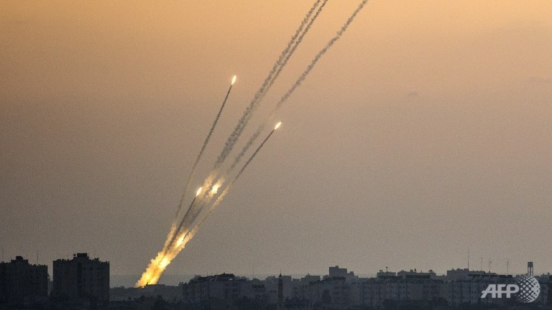
Gaza: 1960-2014
Operation Returning Echo, 2012: Israel kills leading Palestinian terrorist; retaliatory rocket attacks spark assault.
Operation Pillar of Defense, 2012: Assault to stem rocket attacks.

Slide 15
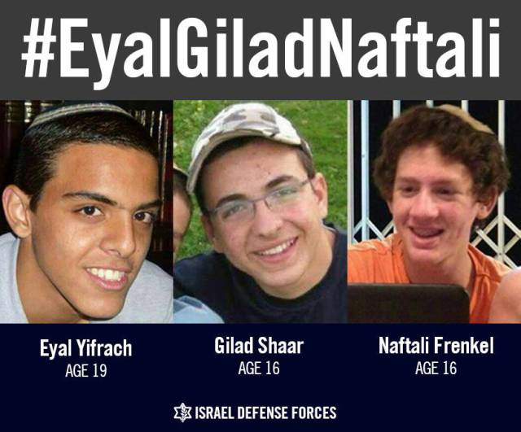
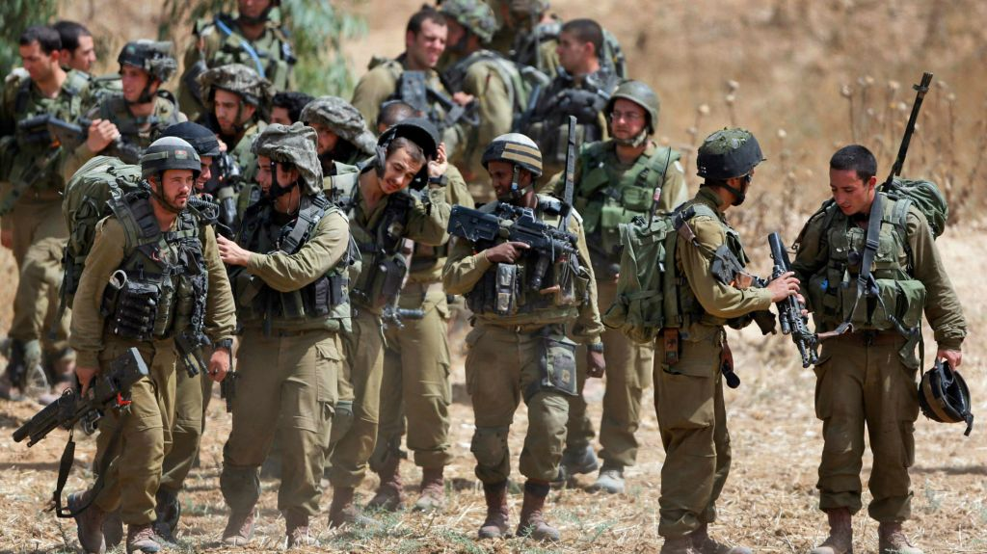
Gaza: 2014
Slaying of 3 Israeli teenagers and reprisal slaying of 1 Palestinian youth leads to conflict
Israel launches Operation Protective Edge with goal of destroying rocket launching capability & destroying tunnel systems

Slide 16
Gaza: Israel is to blame
Perception: Israel attacked Gaza
Reality: It didn’t, Gaza attacked Israel

Slide 17
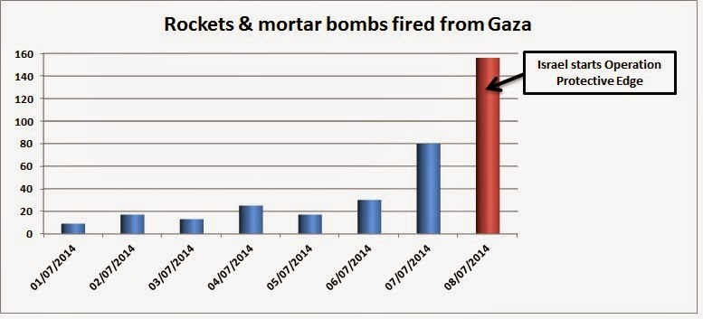
Gaza: Rocket Attacks

Slide 18
Gaza: Hamas isn’t to blame
Perception:
Hamas didn’t launch the rockets, other factions did
Reality:
Hamas is de facto govt
They have shown they can stop rocket attacks when it suits
Hamas have admitted rocket attacks from July 7 onwards

Slide 19
Gaza: Israel is to blame
Perception:
Israel provoked the attacks by carrying out mass arrests
Reality
3 teenagers had been abducted
Israel carried out normal police activity in rounding up the “usual suspects.”

Slide 20
Gaza: Israel is to blame
Perception:
No need for search and therefore provocation, since the teenagers were already dead:
Recording showed shots fired
Blood found in car
Reality:
No conclusive evidence that they were dead
Teenagers could be merely wounded
As long as there was hope the search could not be called off lightly

Slide 21
Gaza: Hamas isn’t to blame
Perception:
Hamas was wrongly accused because
it was a lone cell that did it
It didn’t order it
Reality:
No proof they didn’t order it
Hamas is made up of loosely connected cells
Hamas congratulated whoever did it
They have been exhorting people to carry out such attacks for years

Slide 22
Gaza: Hamas is justified
Perception:
Hamas rightfully wants to kidnap Israelis in order to secure the release of Palestinian prisoners, who languish in prison for decades, often for throwing stones at soldiers.
Reality:
Palestinians are imprisoned up to a year for stone throwing
As is anyone else in the world if guilty of same eg. IRA Terrorists in British prisons
Others guilty of serial or mass murder

Slide 23
Gaza: Israel is to blame too
Perception:
Israel is just as bad as how they try to portray Hamas in that they murdered a Palestinian boy
Reality:
Tragically a Palestinian youth was murdered
Unlike Hamas, the Israeli government strongly condemned it
The alleged murderers have been arrested and will be tried for their crime

Slide 24
Gaza: Israel is to blame
Perception:
Israel’s siege made civilian life unbearable
Reality:
It’s not a siege;
Life is in fact more unbearable for Hamas

Slide 25
Gaza: Israel is to blame
Reality:
Not a siege but a blockade
Hamas is running out of money
Lost Iran as a Sponsor by backing Syrian Rebels
New Egyptian government no longer supports Hamas
No arms, no tax
Failure to form Unity Government
No access to funding from
US
Europe
Gaza leads region on life span, infant mortality and cell phone ownership

Slide 26
Gaza: Israel responded wrongly
Reality:
6 Israelis injured
Iron Dome 80%-90% effective
Fabric of life disrupted
Can’t gamble with life
Perception:
Hamas may have launched many rockets, but they caused little real damage. Israel could just have ignored it.

Slide 27
Gaza: Israel responded wrongly
Perception:
Israel’s response was disproportionate
Hamas is weak and only has unguided home made rockets that did little harm
Israel has much more destructive force
Reality:
Though unguided, Hamas’s rockets are still deadly
Only largely ineffective because of Iron Dome
Tit for tat only results in long war of attrition and disruption

Slide 28
Gaza: Israel responded wrongly
Perception:
Israel‘s decision to mount a ground invasion increased the number of innocent Palestinian victims
Reality:
Carpet bombing would have been the alternative and civilian casualties would have been even greater

Slide 29
Gaza: Israel used excessive force
Perception:
The bottom line is that 2,000 Palestinian died, versus less than 70 Israelis. Surely this is disproportionate and therefore illegal.
Reality:
There is nothing in international law that requires ‘proportionality’ of casualties.
Many more Germans died in World War II, compared to British losses.
During the NATO bombardment and subsequent invasion of Afghanistan, at least 2,000 Afghan civilians were killed, as opposed to 8 NATO soldiers.
The term ‘proportionality’ in international treaties requires loss of life and injury to civilians to be proportional NOT in relation to the loss of life on the other side, but in relation to the military advantage anticipated.

Slide 30
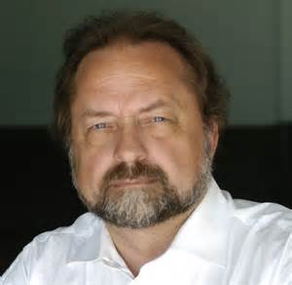
Gaza: Human Shields
Perception:
Israel keeps claiming that Hamas uses Palestinian civilians as human shields. But there is no evidence of that, it’s just propaganda.
Reality:
Considerable number of eyewitness accounts
Patrick Martin, Canadian Globe and Mail
John Ging, UN
Notes:
Patrick Martin, correspondent for the Canadian Globe and Mail, reports from Gaza, in effect describing what international treaties define as use of human shields and perfidy:
“The presence of militant fighters in Shejaia became clear Sunday afternoon when, under the cover of a humanitarian truce intended to allow both sides to remove the dead and wounded, several armed Palestinians scurried from the scene.Some bore their weapons openly, slung over their shoulder, but at least two, disguised as women, were seen walking off with weapons partly concealed under their robes. Another had his weapon wrapped in a baby blanket and held on his chest as if it were an infant.The shelling of Shejaia took its toll of the civilian population there. While the Israelis had warned citizens two days earlier to leave, many had refused in large part because Hamas said it expected people to remain.”
UN official John Ging (certainly no friend of Israel!) confirmed that Hamas is firing rockets into Israel from the vicinity of UN facilities.
An eyewitness (reporter for a Finnish TV station) reports that she just saw a rocket being fired from the parking lot of the Shifa Hospital.

Slide 31
Gaza: Targeting UN facilities
Perception:
UN official said that the coordinates of one of their schools had been transmitted to the Israeli army 33 times. Yet the school was hit. Israel doesn’t discriminate between military and civilian targets
Reality:
Israel has doctrine of returning fire
Many of Hamas’ fining positions are located next to if not inside UN facilities
Secondary explosions from stored munitions
Red on red casualties

Slide 32
Gaza: Peace negotiations
Perception:
Peace negotiations are held with enemies, not friends. Israel is wrong not to negotiate directly with Hamas
Reality:
Israel refuses to negotiate with Hamas for the same reason the US, EU and Britain refuse to deal with them or ISIS
Hamas has taken responsibility for killing civilians
Israel negotiates with PA.

Slide 33
Gaza: Hamas is legitimate
Perception:
Hamas won democratic elections. They are the legitimate Palestinian government so Israel should recognise them.
Reality:
Hamas staged a coup
Elections are not democratic without
Freedom of speech
Freedom of press
Freedom of open debate
Apolitical militia
Austrians sanctioned

Slide 34
Gaza: Hamas wants peace
Perception:
Hamas wants peace provided Israel returns to the 1967 borders
Reality:
Untrue.
Hamas says peace with Israel would violate the precepts of Islam
2008: 10 year truce if
Israel withdraws from East Jerusalem and West Bank
Full right of return

Slide 35
Gaza: UN et al criticise Israel
Perception:
Israel is condemned at the UN and harshly criticised by friendly governments like the UK and even the US. They all can’t be wrong.
Reality:
It is politics:
One Jewish state
22 million Jews, half in diaspora
22 Arab states, pop. 400m
35 states consider themselves Islamic
57 states vote as one
Add economic influence of oil -- Sums to a powerful bloc
Notes:
The condemnations and criticism against Israel have nothing to do with justice; they have everything to do with political power, interest and convenience.

Slide 36
Gaza: Anti-Semitism
Perception:
One can’t criticise Israel without being accused of Anti-Semitism
Reality:
Of course its possible
Anti-Semitism is deep seated
When criticism of Israel is disproportionate and out of context then it is nothing more than a safe way to express subliminal anti-Semitism

Slide 37
Gaza: The Aftermath
Media coverage of war has harmed perceptions of Jews
Anti-Semitic sentiment
Attacks in Europe
Protests in Australasia
Silence from Protest Movement regarding IS
Globe Aliyah up 55%
NZ-Israel relations strained by UN Islamic influence
Peace Negotiations continue
Blockade
Sea port
Airport
Pro-Israel in NZ protests met with respect
Collaboration across country great to see

